Slide 1

SESHADRI RAO GUDLAVALLERU ENGINEERING COLEGE
(An Autonomous Institute permanently affiliated to JNTUK , Kakinada)
Department of Electronics and Communication Engineering
Braille-Based IoT Home Automation for
Multi-Disability Empowerment
Batch No : C5
Batch Members:
N. Manikanta Raghava — 23485A0424
M. Jahnavi — 22481A04F5
N. Venkata Siva Prasanth — 23485A0423
Md. Habeeb Pasha — 22481A04F8
Guided by:
Mr. V. Vittal Reddy
(Associate Professor)

Slide 2
Presentation Flow
Introduction
Objectives
Abstract
Hardware and Software details
Architecture diagram
System execution flow
Module Communication & Braille Recognition
Supported Commands & Feedback Patterns
Light Control
Fan Controlling Capacitive Regulator
Capacitive Regulation in Fan Speed Control
Emergency System Working
Overcoming Fire Detection Challenges
IoT Integration
Password circuit operation
Outputs
Conclusion and Future Scope

Slide 3
Introduction
The advancement of IoT has enabled smart home automation, but most systems rely on visual interfaces or voice commands, making them difficult for visually impaired users to operate independently. These systems often fail in noisy environments and do not provide reliable, accessible control.
To address this challenge, this project proposes a Braille-Based IoT Home Automation System that enables users to control home appliances through a tactile Braille keypad, eliminating the need for sight or voice.
The system uses ESP32-based dual modules for wireless communication and appliance control. A 6-button Braille interface converts user input into commands, while relays control devices like lights, fans, and door locks. To enhance usability, buzzer and vibration feedback provide real-time confirmation. Additionally, a dual-sensor safety system (IR + Gas) ensures accurate fire detection, and Blynk IoT integration allows remote monitoring and alerts.

Slide 4
Objectives of the Project Work
Develop a low-cost, accessible Braille-based IoT system that empowers visually and speech-impaired individuals to control home appliances independently, providing real-time confirmation through haptic feedback and auditory feedback to ensure ease of use.
Implement an intelligent emergency alert system that detects hazards like fire and notifies caregivers via Blynk IoT cloud push notifications upon user confirmation.

Slide 5
Abstract of the Project Work
This project presents a Braille-based IoT home automation system designed to assist visually and speech-impaired individuals. Built on ESP32 microcontrollers, the system employs a custom persistent TCP protocol to transmit commands from a portable six-dot Braille keypad to a central appliance controller. Accessibility is ensured through simultaneous haptic (vibration) and auditory feedback for the user, while an SSD1306 OLED display provides visual status for caregivers. Additionally, the system integrates flame sensors and Blynk IoT connectivity to provide real-time safety alerts, offering a secure, reliable, and inclusive alternative to conventional smart home controls.

Slide 6
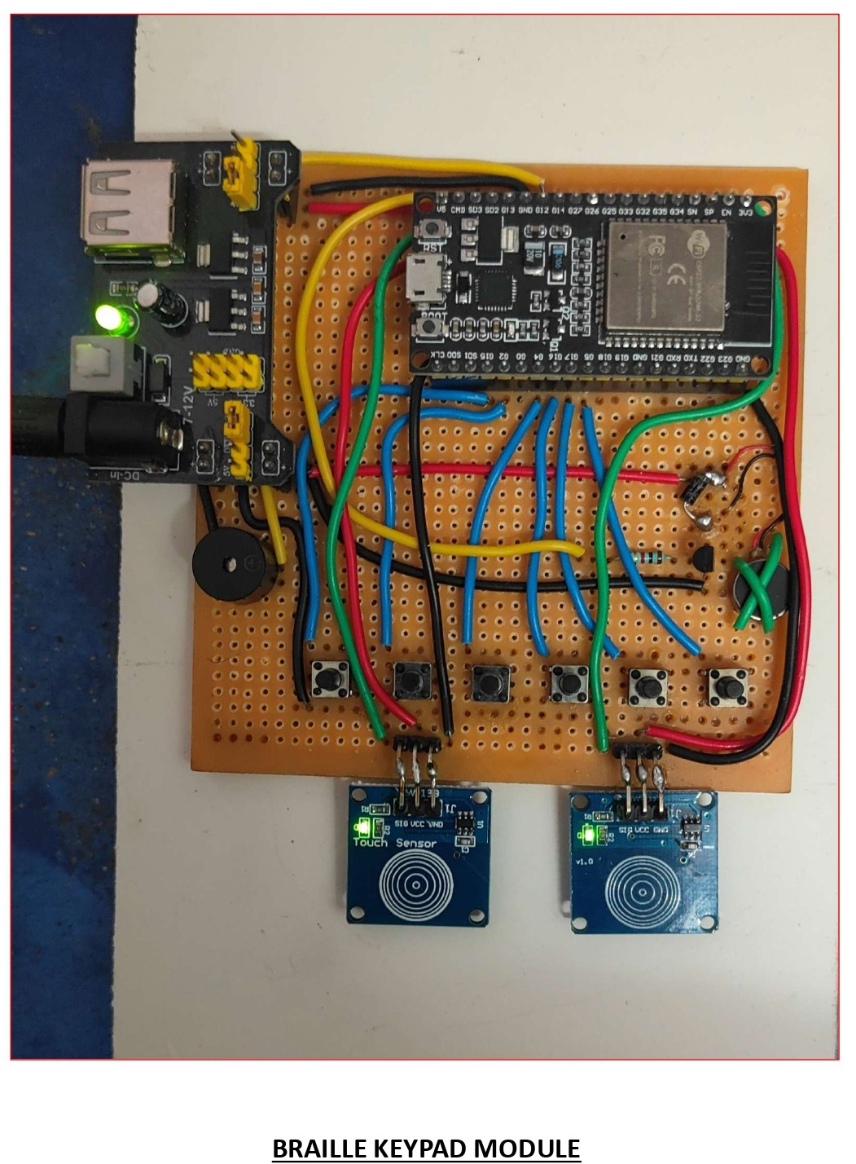
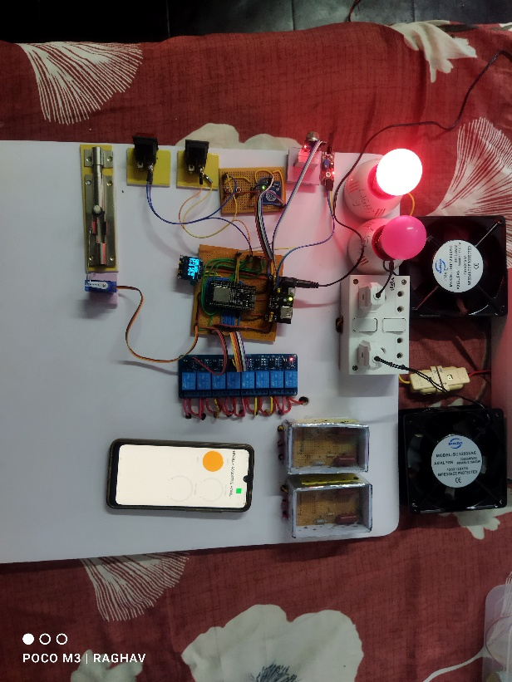
Hardware & Software Details
Hardware Components
Controllers
2× ESP32-WROOM-32 modules for Remote and Appliance control. Dual-core processor with Wi-Fi/Bluetooth, 4MB flash memory.
Input Peripherals
9× Pushbuttons (6 for Braille + 3 auxiliary), 3× TTP223 Touch Sensors (mode selection & confirmation), 1× IR Flame Sensor (fire detection)
Output Peripherals
1× Vibration Motors with 2N2222 transistor drivers, 1× Buzzers (audio feedback), MG995 Servo (door lock), SSD1306 OLED (status display)
Switching Module
8-Channel Relay module for AC appliance control. Optocoupler isolation, LED indicators, NO/NC terminals. Rated 10A , 250VAC.
Software Environment
Programming
Developed using C++ in Arduino IDE with ESP32 core libraries
Connectivity
TCP/IP Server-Client architecture with AP+STA mode
IoT Integration
Blynk IoT platform for remote monitoring and push notifications

Slide 7
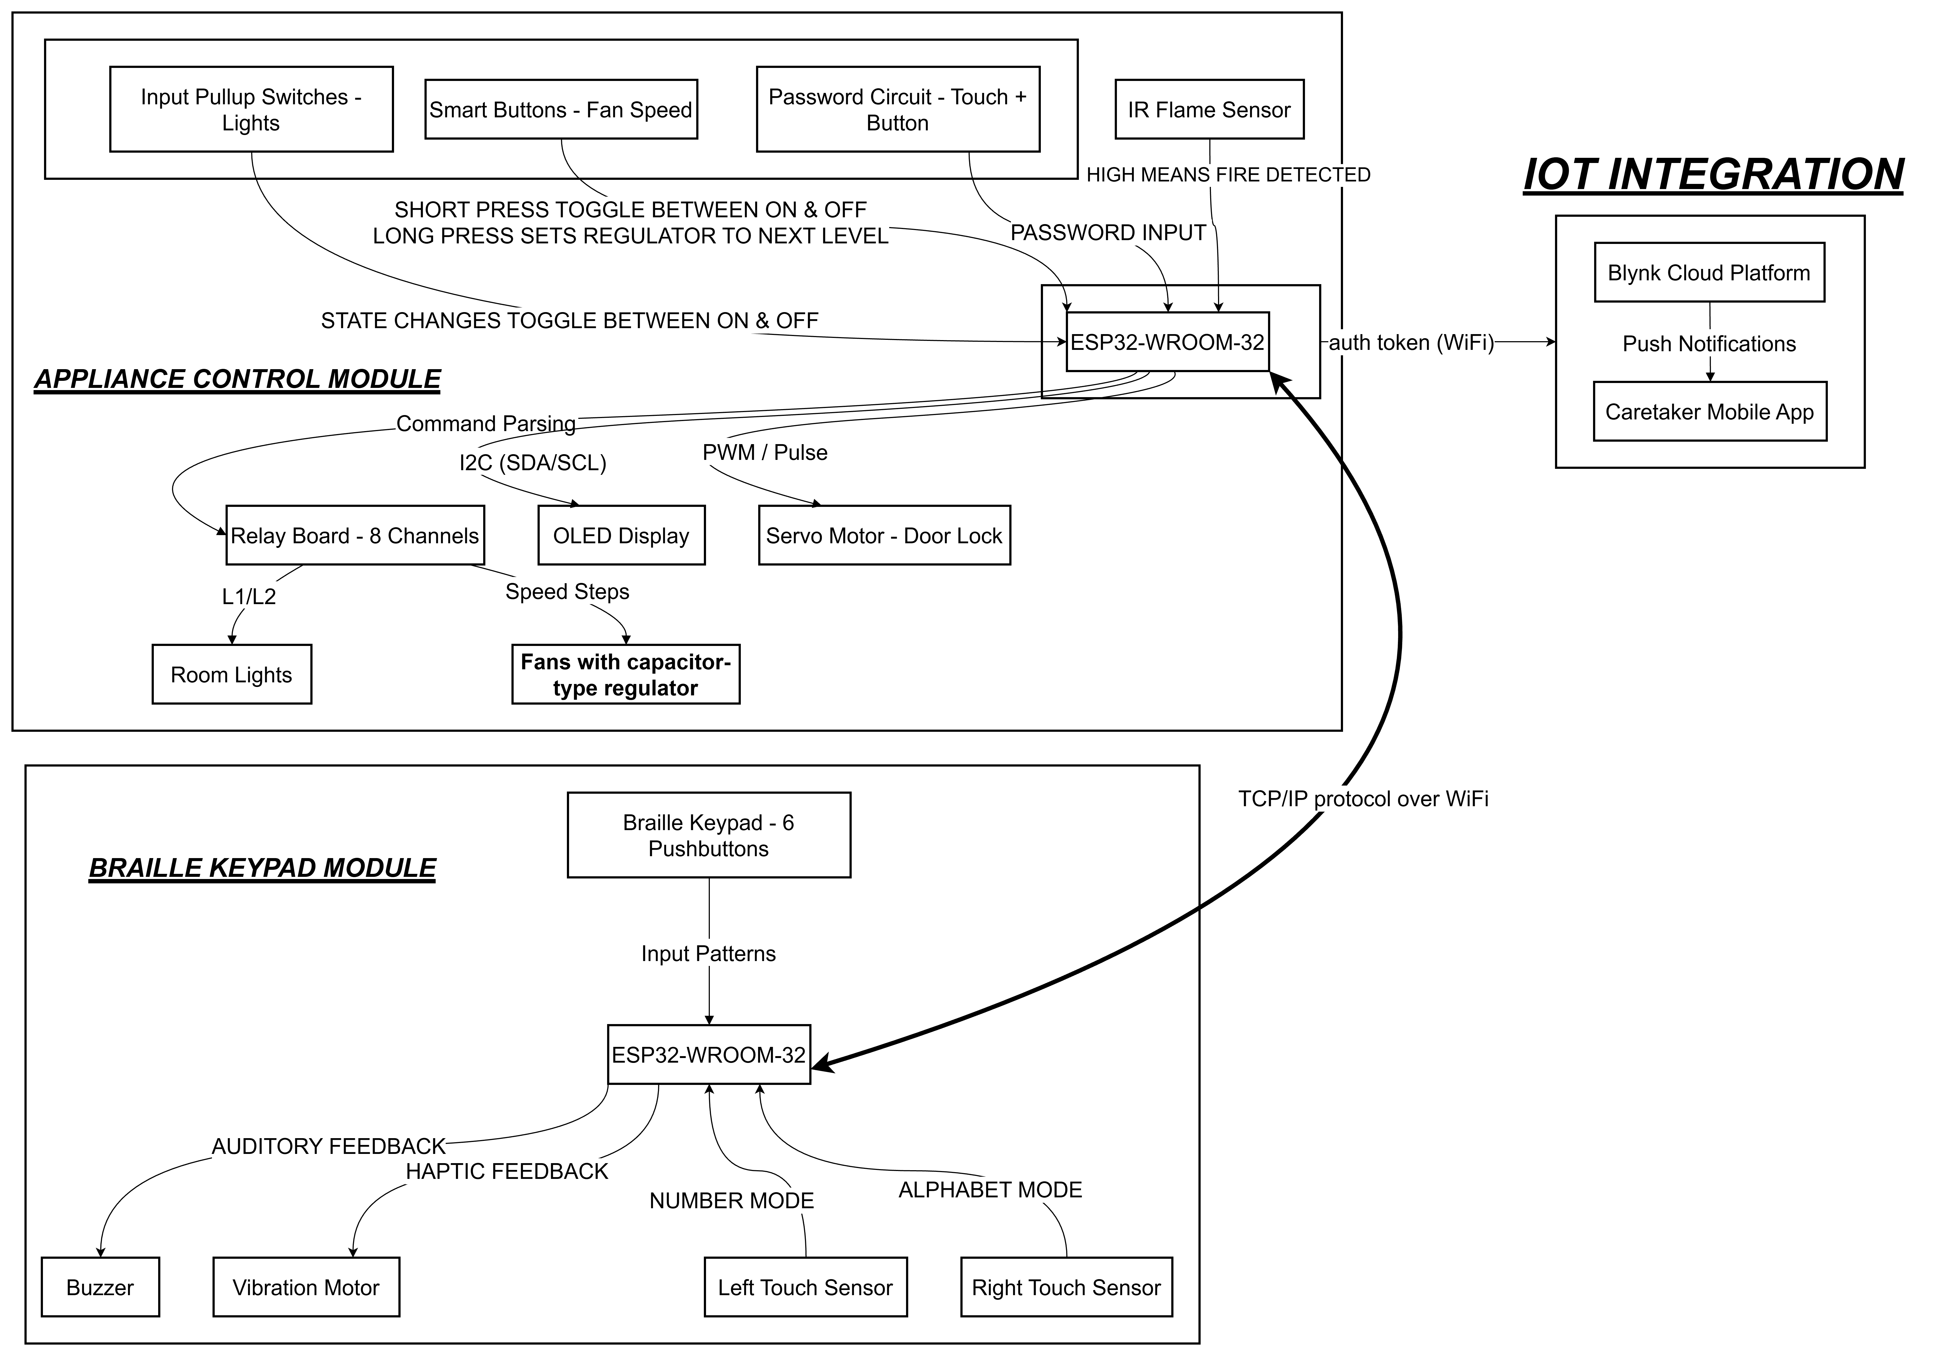
Architecture Diagram

Slide 8
System Execution Flow
Braille Keypad Module
Power ON
Initialize sensors & Wi-Fi
Read inputs
Valid Braille Input
Send appliance command
No
Is Feedback Received
Yes
Play Feedback
Emergency
Send ACK or STOP
Wire less communication
through Wi-Fi using TCP/IP
Appliance Control Module
S/E/C/W
feedback pattern →
Is Command Received
Initialize sensors, Wi-Fi & Display
Power ON
Listen TCP for commands
Yes
Decode command
Execute command & give Feedback
No
‘F’ fire alert
feedback pattern →
Update display
Is Flame detected
Monitor Flame sensor &MQ2 gas sensor
Yes
Emergency alert
No

Slide 9
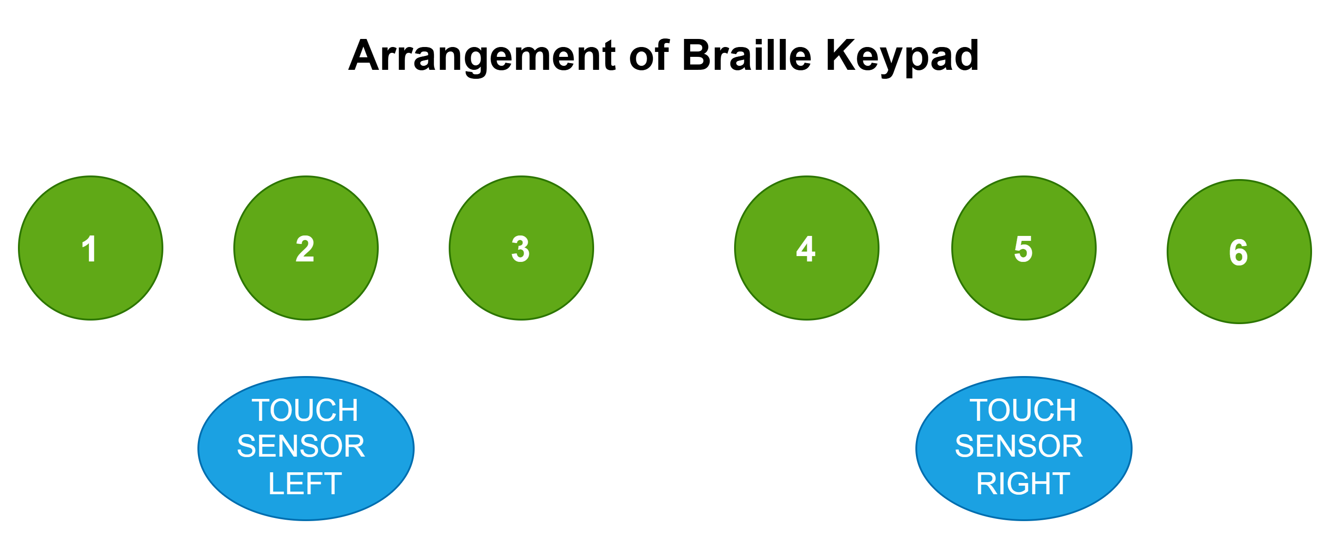
Module Communication & Braille Recognition
System Connectivity
Lookup Table & Pattern Mapping
Network Topology
The brailleMap[] stores decimal equivalents of Braille dot patterns to match physical input to characters.
Operates on a Master/Slave model where the Remote Module (TCP Client) connects to the Appliance Module (TCP Server) on Port 7890 .
Dual-Mode Wi-Fi
// Braille Lookup Table (A-Z)
Utilizes WIFI_AP_STA mode to allow either connection via a router or direct peer-to-peer (AP) connection.
const byte brailleMap[] = {
1, 3, 9, 25, 17, 11, 27, 19, 10, 26, // A-J
5, 7, 13, 29, 21, 15, 31, 23, 14, 30, // K-T
37, 39, 58, 45, 61, 53 // U-Z
};
The Braille Recognition Engine
The system uses bitwise logic to convert physical inputs from a 6-dot cell into a binary pattern.
Mode Logic: Alphabet vs. Number
// Bitwise Pattern Detection
// Mode Differentiation Logic
byte pattern = 0;
for (int i=0; i<6; i++) {
if (digitalRead(btnPins[i]) == LOW)
pattern |= (1 << i); // Map buttons to binary bits
}
if (tR) detectedChar = brailleChars[i];
// Right touch = A-Z
else if (tL)
detectedChar = (i < 9) ? (i + 1) + '0' : '0';
// Left touch = 1-0
Touch Sensors:
• Left (tL): Number mode (1-0)
• Right (tR): Alphabet mode (A-Z)
• Both: Command confirmation

Slide 10
Supported Commands & Feedback Patterns
Appliance Command Set
Haptic & Audio Feedback Timing
L1 / L2
Toggles light relays on Pins 13 and 12
The system ensures immediate confirmation for visually impaired users.
S
Success ('S')
Fxy
Controls Fan x (Room 1/2) at Speed y (0–4)
400ms pulse for confirmed actions
OPN
Rotates door servo to 90°; auto-closes after 5 seconds
E
Error ('E')
800ms long pulse for invalid commands
ALL1 / ALL0
Master override for all devices
C
Correct Password ('C')
Command Parsing Implementation
5 short pulses (400ms ON / 200ms GAP)
W
Wrong Password ('W')
if (inputBuffer == "L1") {
l1State = !l1State;
digitalWrite(RELAY_L1, l1State);
preferences.putBool("l1", l1State);
Blynk.virtualWrite(V1, l1State);
response = 'S';
}
else if (inputBuffer.startsWith("F")) {
int r = inputBuffer.charAt(1) - '0';
int s = inputBuffer.charAt(2) - '0';
if (r==1) { fan1State=s; setFan1Speed(s); }
}
5 long pulses (800ms ON / 200ms GAP)
Feedback Function Implementation
void triggerFeedback(char type) {
if (type == 'S') { // 400ms
digitalWrite(vibMotor, HIGH);
delay(400);
digitalWrite(vibMotor, LOW);
}
else if (type == 'C') { // 5× short
for (int i=0; i<5; i++) {
digitalWrite(vibMotor, HIGH);
delay(400);
digitalWrite(vibMotor, LOW);
if (i<4) delay(200);
}
}
}

Slide 11
Light Control
Toggle Logic
Implementation Code - Light Toggle Function
Commands like "L1" or "L2" trigger a toggle function to reverse the relay state. The system uses active-LOW relay logic where LOW signal activates the relay.
if (inputBuffer == "L1") {
l1State = !l1State;
digitalWrite(RELAY_L1, l1State ? RELAY_ON : RELAY_OFF);
preferences.putBool("l1", l1State);
if(Blynk.connected()) Blynk.virtualWrite(V1, l1State);
response = 'S';
statusChanged = true;
}
else if (inputBuffer == "L2") {
l2State = !l2State;
digitalWrite(RELAY_L2, l2State ? RELAY_ON : RELAY_OFF);
preferences.putBool("l2", l2State);
if(Blynk.connected()) Blynk.virtualWrite(V2, l2State);
response = 'S';
statusChanged = true;
}
Command Structure
L1, L2
Toggle individual lights
ALL1
Turn all lights ON
ALL0
Turn all lights OFF
Manual Mode
Physical input pull-up switches allow manual toggling. The ESP32 detects state changes through interrupt-based monitoring and updates the system accordingly. Manual overrides are immediately synchronized with the IoT platform.
IoT Synchronization
Every state change is synced to the Blynk app for remote viewing. Virtual pins V1 and V2 represent Light 1 and Light 2 states respectively, enabling real-time monitoring from anywhere.
Key Feature: Persistent memory using ESP32 Preferences library ensures lights maintain their state even after power cycles.

Slide 12
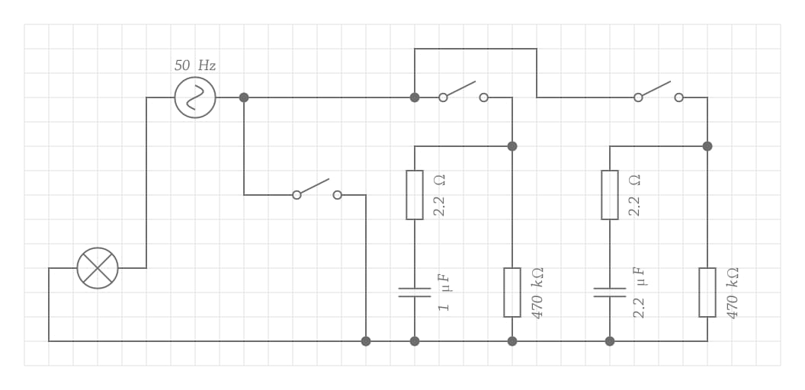
Capacitive Regulation in Fan Speed Control
Control Method
Manual Control
Speed control is achieved through a capacitive regulation circuit using relays. The method employs parallel capacitor switching to vary the effective capacitance, thereby controlling the voltage across the fan motor and regulating its speed.
Smart button logic supports dual-function operation through press duration detection:
Short Press (<500ms)
Toggles fan ON/OFF state
Speed Levels
Long Press (>500ms)
Provides 5 levels (0 to 4) by switching capacitor values in parallel:
Cycles through speed levels 1→2→3→4→1
Speed | Active Relays | Capacitance | Description
0 (Off) | None | 0 µF | Off position
1 (Low) | Relay 1 | 1.0 µF | Minimum speed
2 (Low-Med) | Relay 2 | 2.2 µF | Medium-low speed
3 (Med-High) | Relays 1 & 2 | 3.2 µF | Medium-high speed
4 (Max) | Relay 3 | Bypass | Full AC voltage
Relay 1
Relay 2
Relay 3
FAN / 60w bulb
Figure 3: Capacitive Fan Speed Regulator Circuit Diagram
Circuit Components: R1,R3 = 220kΩ, R2,R4 = 2.2Ω, C1 = 1.0µF/400V(CB22 105J400V), C2 = 2.2µF/400V(CB22 225J400V)

Slide 13
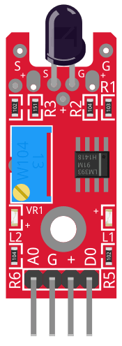
Emergency System Working
Fire Detection
Confirmation Protocol
The IR Flame sensor continuously monitors for fire using infrared detection. When fire is detected (sensor output HIGH), the system initiates the emergency protocol.
User confirmation is required before sending emergency notifications to prevent false alarms:
BOTH Sensors Held (>2s)
Detection Logic
→ Sends "ACK" → Blynk notification sent → Door opens automatically
// Fire Sensor Logic (ACTIVE HIGH)
ONE Sensor Held (>2s)
if (digitalRead(FLAME_PIN) == HIGH) { if (!fireActive) { fireActive = true;
updateOled(
→ Sends "STOP" → False alarm → No notification sent
"!! FIRE !!" ); }
if (activeClient.connected()) activeClient.print(
); }
'F'
Current Challenge
The system is encountering high IR sensitivity where the sensor incorrectly identifies:
Alert State
Direct sunlight / bright ambient light
Upon receiving the 'F' signal, the Remote Module enters emergency mode:
Incandescent bulbs (60W and above)
Continuous Alert Pattern
Solution Required: Implement threshold calibration or use UV-IR dual-spectrum sensor for improved accuracy.
Short vibration + beep every 1 second
IR Flame Sensor Module for flame Detection

Slide 14
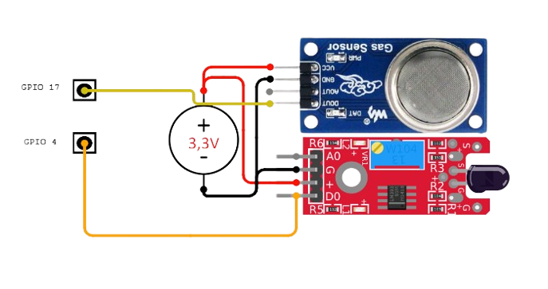
Overcoming Fire Detection Challenges
The Challenge: Sensor Sensitivity
The Solution: Multi-Sensor Fusion Logic
High IR Sensitivity: Initial testing revealed the IR Flame sensor incorrectly identified direct sunlight and bright ambient light as fire.
Artificial Light Interference: Incandescent bulbs (60W and above) frequently triggered false positives.
Caregiver Alert Fatigue: Automatic, unverified alerts often lead to caregivers ignoring legitimate crises.
Dual-Trigger Requirement: Implemented a strict "AND" logic gate; an alert only initiates if both the IR Flame sensor and MQ-2 gas sensor cross thresholds simultaneously.
Environmental Filtering: This synchronized trigger successfully separates genuine fire events from common interference like cooking activity or sunset saturation.
human-in-the-loop Protocol: Notifications are not automatic. The system requires a physical acknowledgment gesture from the user to verify the hazard before dispatching cloud alerts.
Emergency Execution Flow
Local Alert: Remote Module enters a continuous 400ms beep/vibration cycle every 1 second upon detection.
User Confirmation (ACK): Holding BOTH touch sensors for >2s confirms the fire, sends a Blynk notification, and opens the door automatically for egress.
False Alarm Dismissal (STOP): Holding ONE sensor for >2s silences the alert and prevents unnecessary caregiver notification.

Slide 15
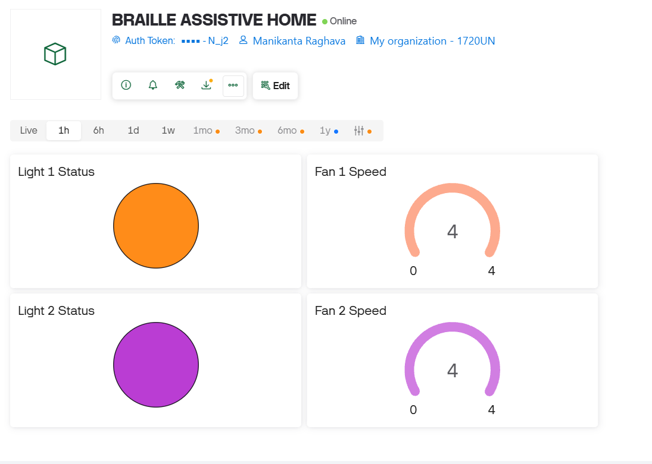
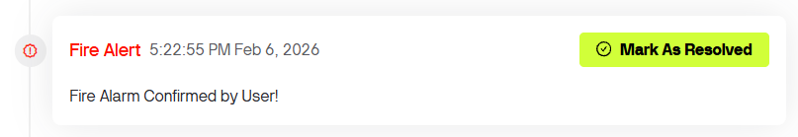
IoT Integration
Blynk Virtual Pin Mapping
Blynk Synchronization Code
The system syncs hardware states to the cloud for remote monitoring.
// Hardware → Cloud (State Updates)
if(Blynk.connected()) {
Blynk.virtualWrite(V1, l1State);
Blynk.virtualWrite(V2, l2State);
Blynk.virtualWrite(V3, fan1State);
Blynk.virtualWrite(V4, fan2State);
}
// Cloud → Hardware (Control Commands)
BLYNK_WRITE(V1) {
l1State = param.asInt();
digitalWrite(RELAY_L1, l1State);
}
Virtual Pin | Device Assignment | Data Range
V1 | Light 1 Status | 0 (OFF) – 1 (ON)
V2 | Light 2 Status | 0 (OFF) – 1 (ON)
V3 | Fan 1 Speed | 0 – 4
V4 | Fan 2 Speed | 0 – 4
// Fire Detection Loop (Active HIGH)if (digitalRead(FLAME_PIN) == HIGH) {
if (!fireActive) {
fireActive = true;
updateOled("!! FIRE !!");
}
if (millis() - lastFireMsg > 1000) {
lastFireMsg = millis();
activeClient.print('F'); // Alert remote
}
}
// ACK: Confirmed Emergencyif (inputBuffer == "ACK") {
fireActive = false;
doorServo.write(90); // Open door
Blynk.logEvent("fire_alert",
"Fire Alarm Confirmed!");
}
Emergency Response Implementation
Notification on Blynk cloud
Table 10: Blynk IoT integration and safety system architecture
Braille-Based IoT Home Automation

Slide 16
Password circuit operation
Component Logic
Submission Protocol
The password entry system uses a simplified binary input mechanism with two components working together:
A long press (>2 seconds) on the touch sensor submits the entered password string for validation. The system provides immediate visual feedback on the OLED display.
Operation Sequence
Touch Sensor
Pushbutton
①
Tap touch to select bit position
Acts as "Clock/Enter"
Acts as "Data Bit"
②
Hold button + touch for '1', touch only for '0'
TTP223 Module
INPUT_PULLUP Mode
③
Long press touch (>2s) to submit password
④
Long press button to clear and re-enter
Data Entry Protocol
Access Control
1
Bit Value '1'
The system validates the entered password against the default password "1010" . Upon successful validation, the MG995 servo motor rotates to 90° to grant door access.
Button press + Touch sensor activation
0
Bit Value '0'
Correct Password
Wrong Password
Touch sensor only (no button press)
5 short beeps/vibrations
5 long beeps/vibrations
Servo → 90° (Door Open)
Servo → 0° (Locked)

Slide 17
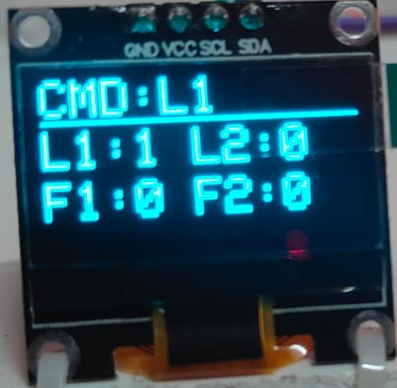
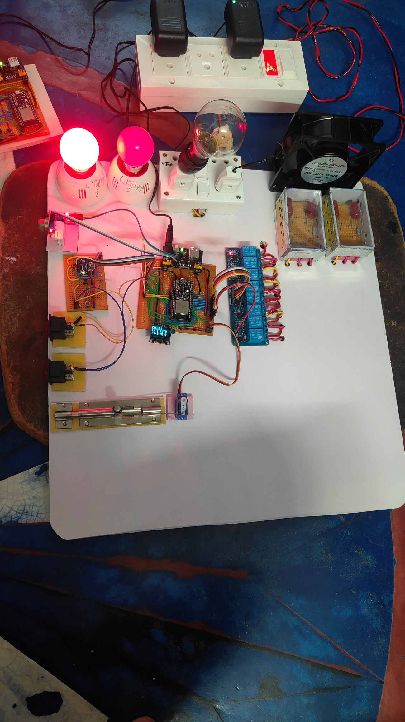
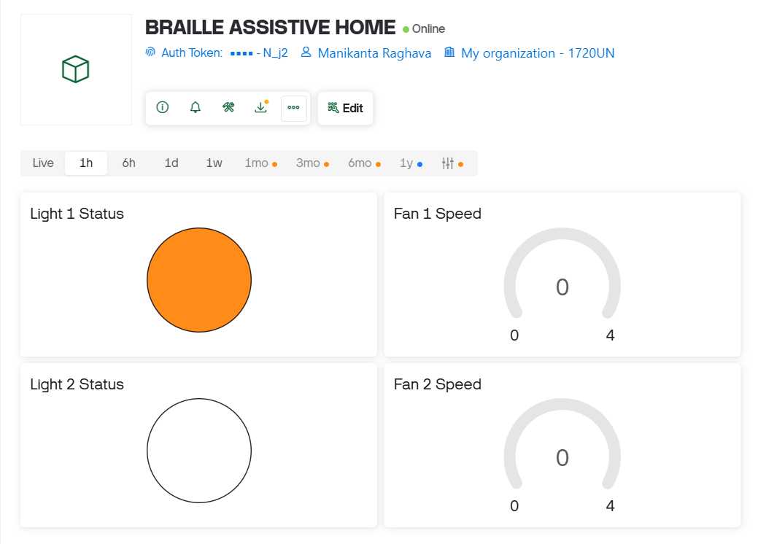
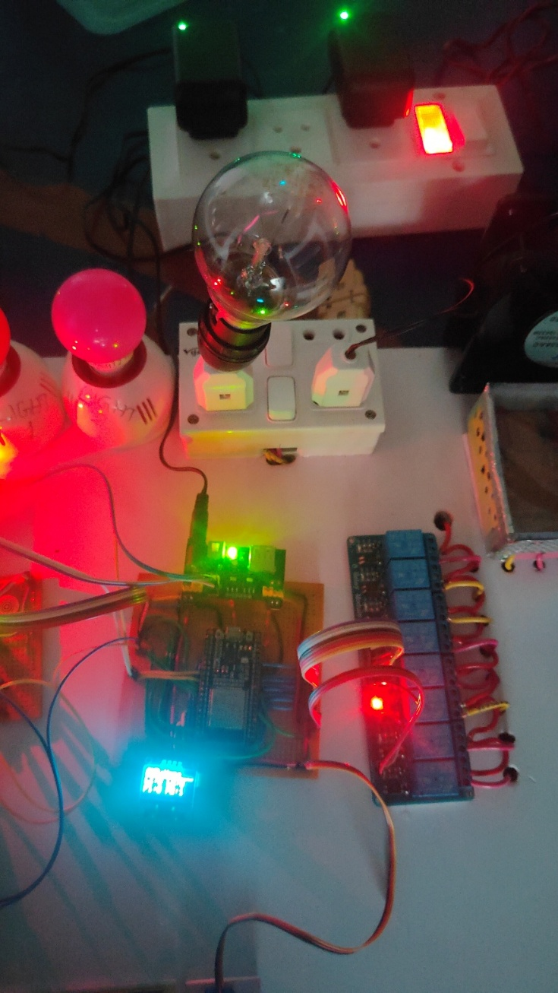
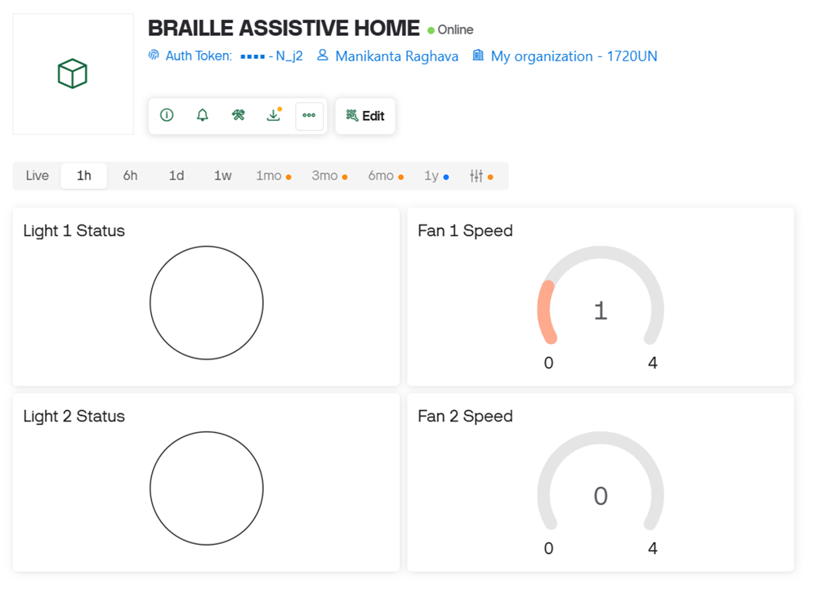
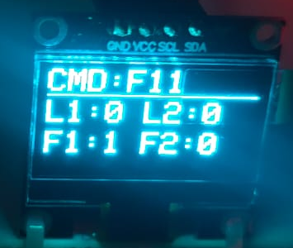
OUTPUTS
Appliance control module response for command L1
Up on giving the input L1 input by the pressing button 1,2,3 & touching right touch sensor for typing L and button 1 & touching left touch sensor for typing 1, then entered command by a short touch on both sensors, then the light 1 state toggled to on state i.e. there is a transition from OFF to ON.
Hardware output showing fan1 at regulation level 1
Up on giving the input F11 input by the pressing button 1,2,4 & touching right touch sensor for typing F and button 1 & touching left touch sensor for typing 1 for two times, then entered command by a short touch on both sensors, then the relay connected to high reactance rc channel of regulator, as it is difficult to display air breeze on photo I have used incandescent bulb as it show brightness change for each regulation level.

Slide 18
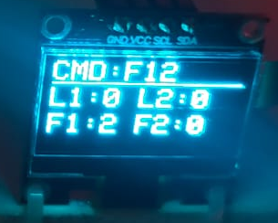
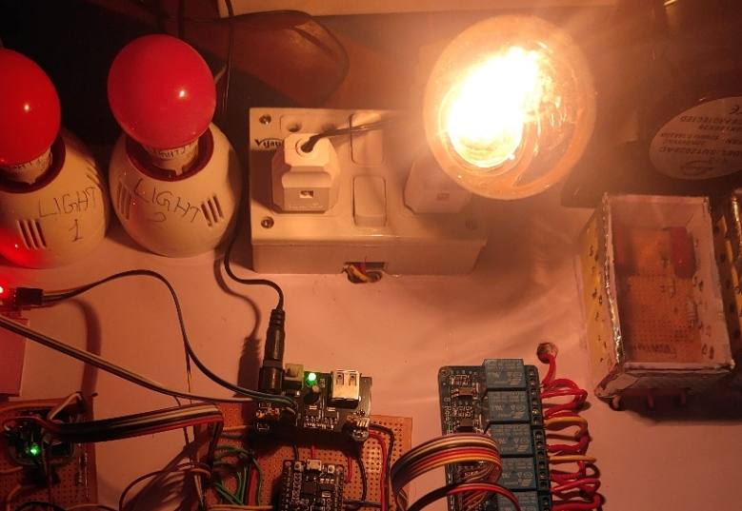
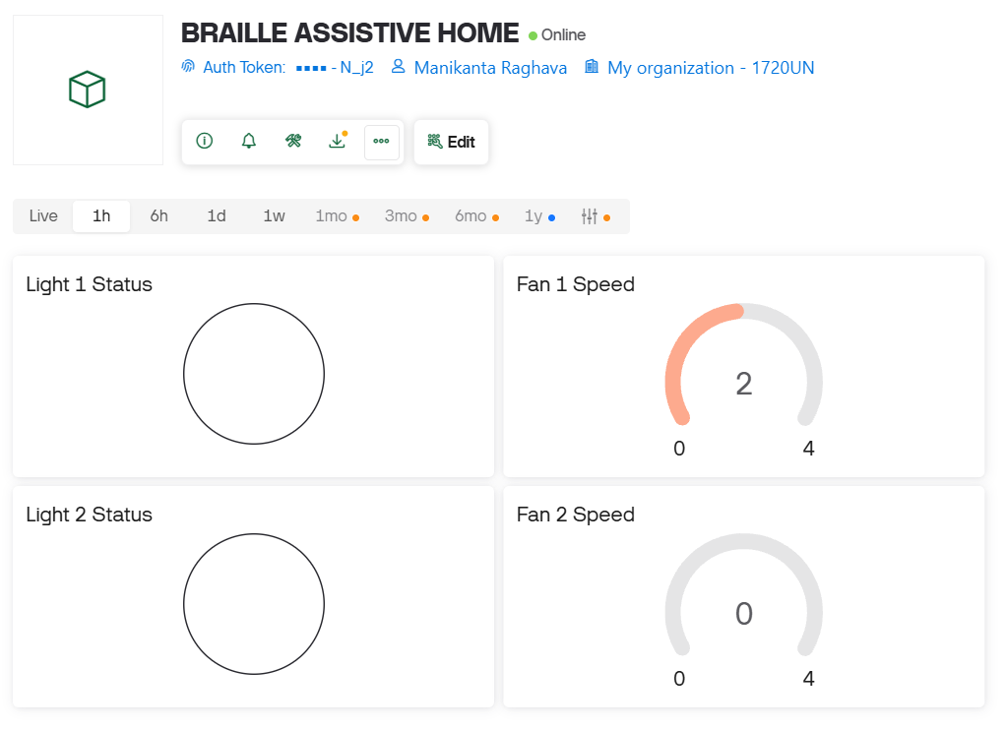
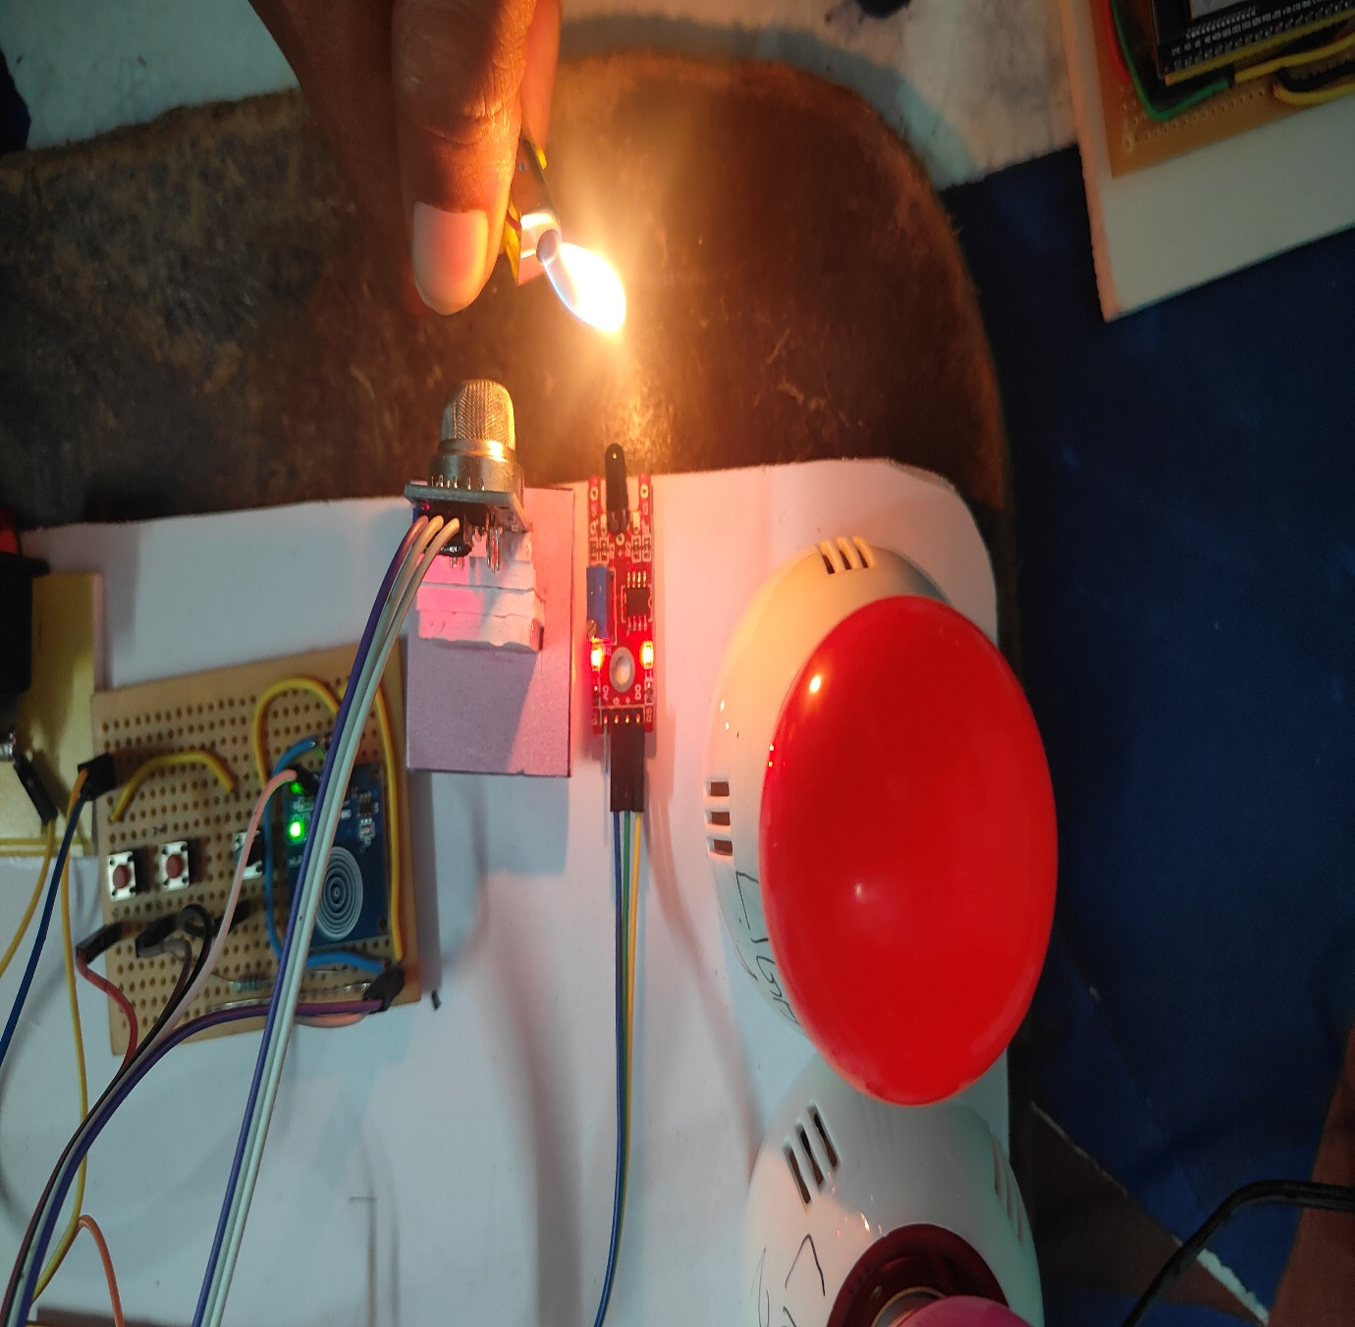
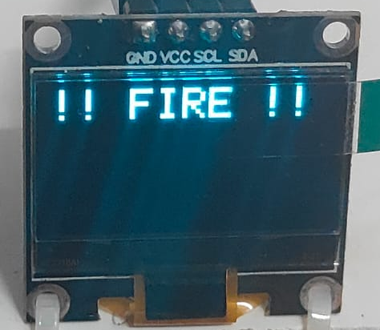
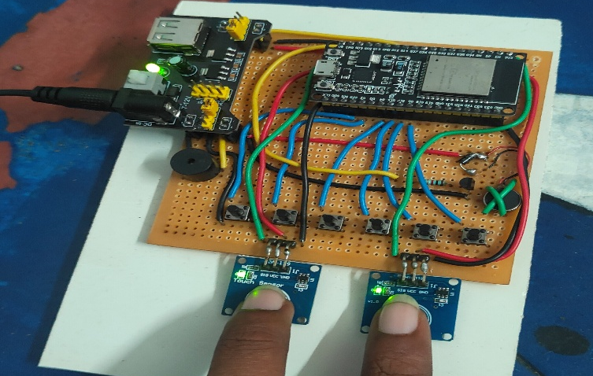
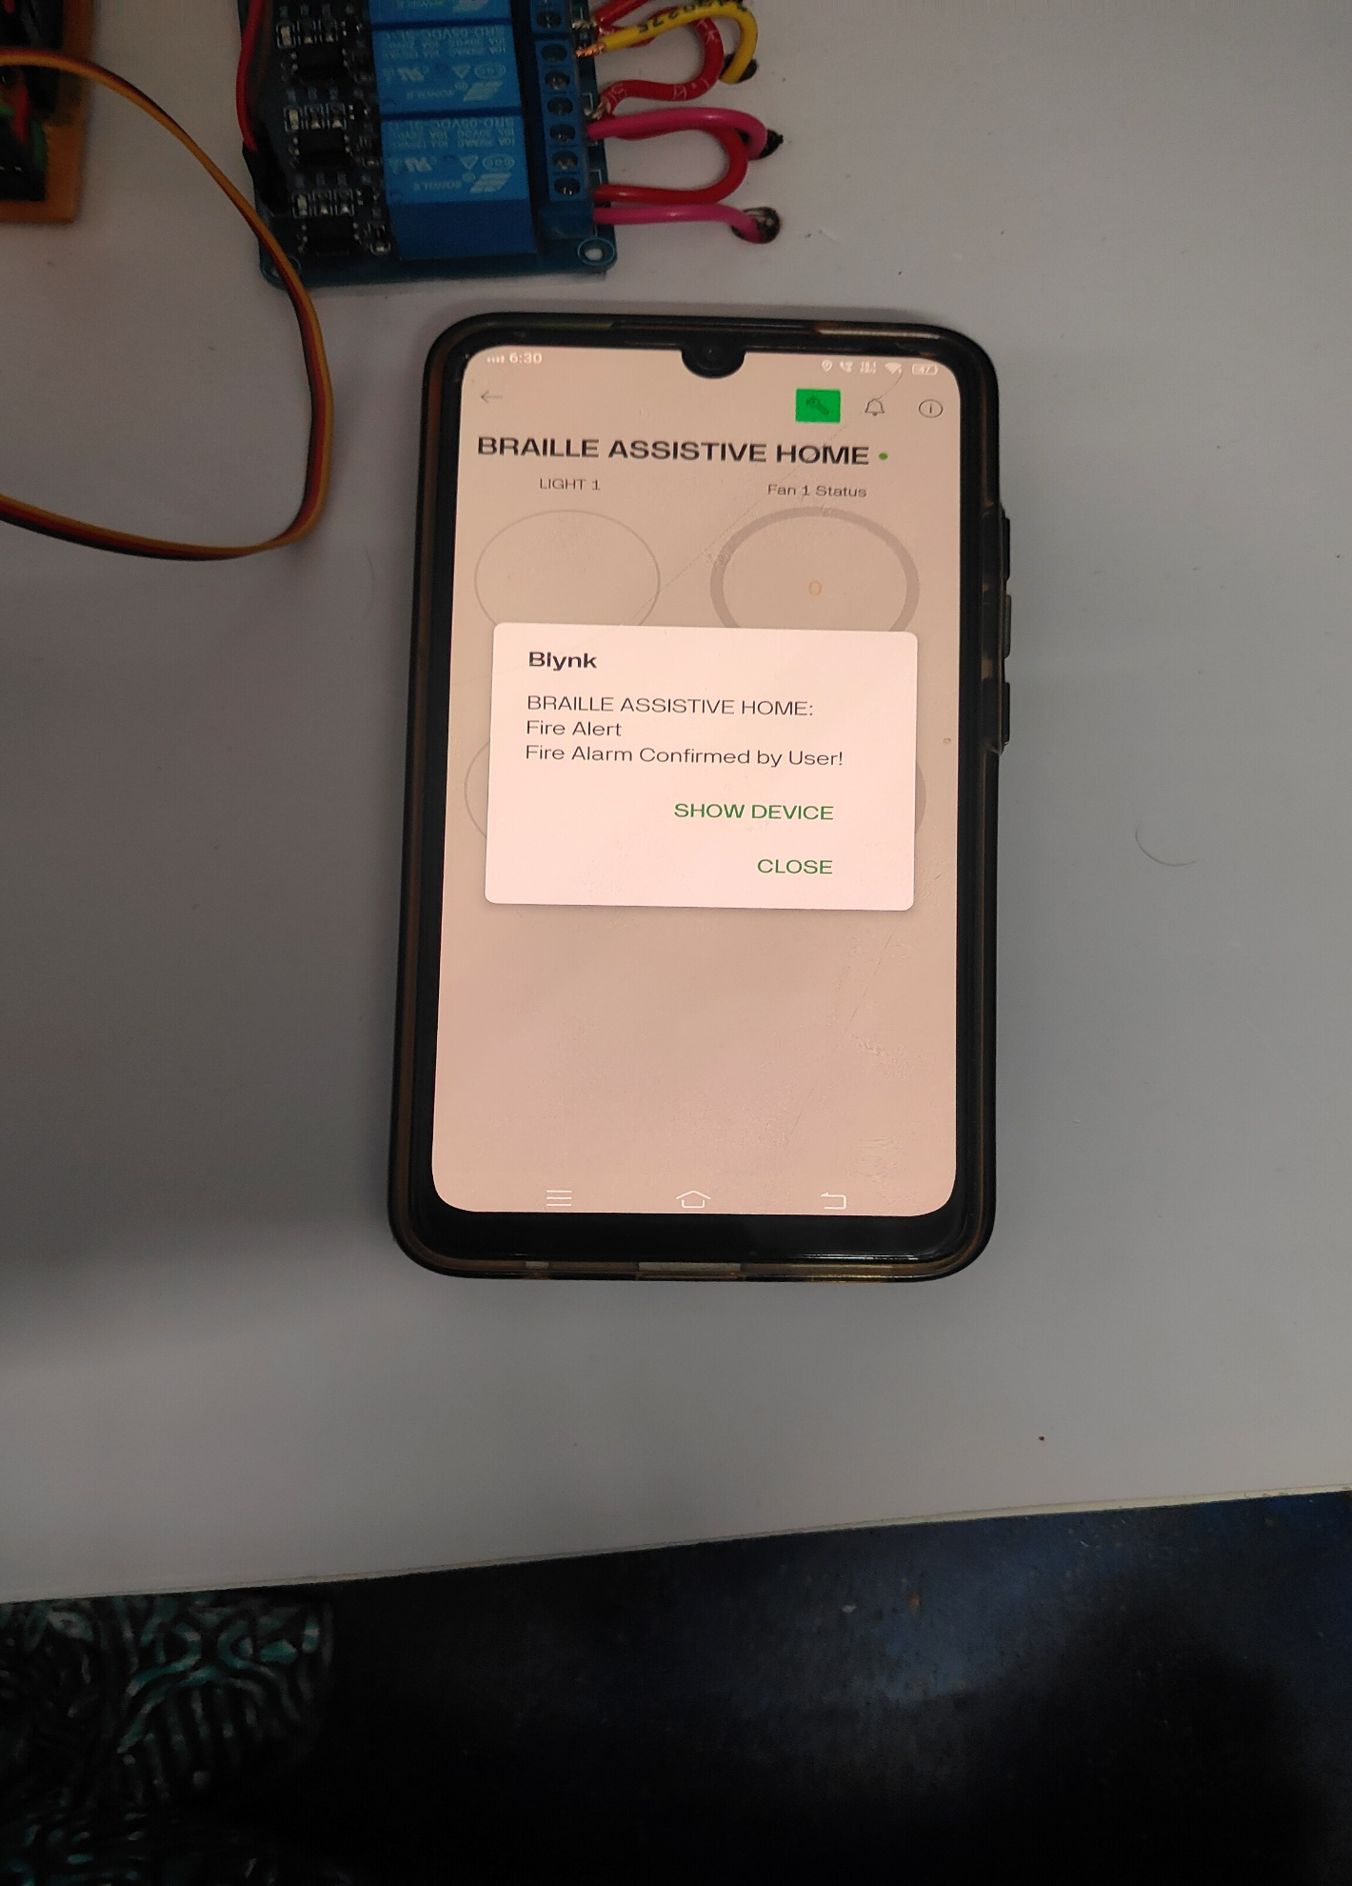
OUTPUTS
Hardware output showing setting fan1 to regulation level 2
Up on givinig the input F12 input by the pressing button 1,2,4 & touching right touch sensor for typing F , button 1 & touching left touch sensor for typing 1 & button 1,2 & touching left touch sensor for typing 2, then entered command by a short touch on both sesnors, then the relay connected to high reactance rc channel of regulator, as it is difficult to display air breeze on photo I have used incandesecnt bulb as it show brightness change for each regulation level.We can observe the highest brightness at level 4 as it bypass the RC networks.
Stimulating fire monitoring system
To simulate a high-reliability fire monitoring system, the MQ-2 gas sensor was triggered using smoke to detect combustible particles, while a cigar lighter provided the infrared (IR) signature needed to activate the flame sensor.
The system utilizes a 2-second dual-touch hold on the TTP223 capacitive sensors to transfer the ACK command. The ACK command specifies that user confirmed the fire is unintentional & he is in danger and need to notify the care taker.
The appliance control module processed the ACK(acknowledgement) command and delivered a notification to care taker via Blynk IoT app.

Slide 19
Conclusion and Future Scope
Conclusion
Tactile-First Design: Successfully integrated a sight-independent home automation system using the universal six-dot Braille code as the primary control interface.
Architectural Resilience: The dual-ESP32 topology isolated sensitive input logic from high-voltage relay noise and maintained local functionality without external internet.
Unambiguous Feedback: A structured five-pattern audio-haptic encoding scheme provided real-time system confirmation without needing visual displays.
Reliable Safety: The dual-sensor "AND" logic for fire detection effectively eliminated single-sensor false positives caused by sunlight or artificial light.
Verified Emergency Response: The "human-in-the-loop" protocol ensured that caregiver notifications represent only user-verified emergencies, reducing alert fatigue.
Future Scope
Compact Wearable Architecture: Evolving the system into a miniaturized, wearable form factor to enhance portability, ergonomics, and ease of use in mobile environments.
Braille-to-Voice Integration: Implementing new auditory features to convert Braille input into spoken output, facilitating more effective interaction for a wider range of users.

Slide 20

References
Serhat Küçükdermenci, “Raspberry Pi Based Braille Keyboard Design With Audio Output,” ICMAR 2023
Nabil Litayem, “Scalable Smart Home Management With ESP32-S3: A Low-cost Solution For Accessible Home Automation,” ICCA 2024
T. V. Lakshmanan, “Assistive Iot Technologies For The Differently-abled,” IEEE Access, 2022
AP/STA communication between esp32s “https://youtu.be/2z7Ow4PjJRc?si=FlW6IwR_eVhzwoQw”
ESP-now communication protocol for esp32 “https://youtu.be/xOLG-88Ld3A?si=BnvgO9c1dykmINd2”

Slide 21

Paper Publication
The project work has been published as a peer‑reviewed research paper in the IJERT journal. The paper explains the system architecture, experimental procedure, and performance results in an organized manner.
It contains numerical data, theoretical discussion, and verification of the results. The article can be accessed using the DOI link (https://doi.org/10.5281/zenodo.19185378), which gives a permanent and citable reference for the work. The QR code below takes the reader directly to the IJERT webpage where the paper is hosted, allowing quick access to the full text for study and citation.

Slide 22
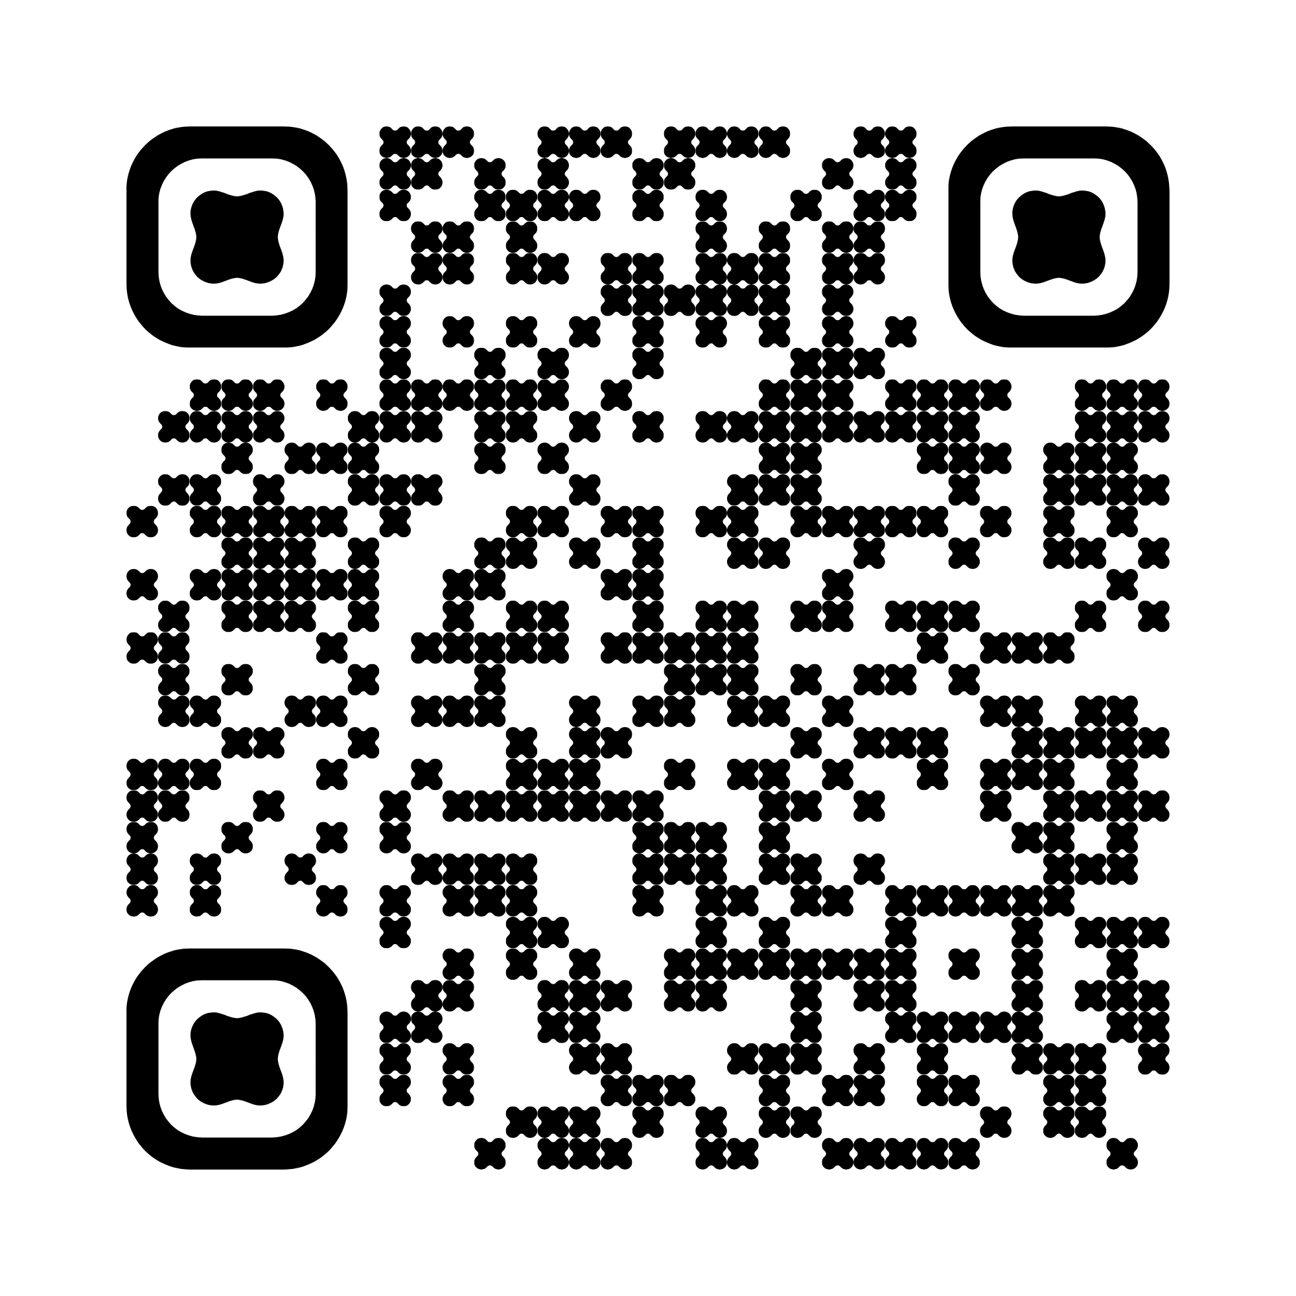
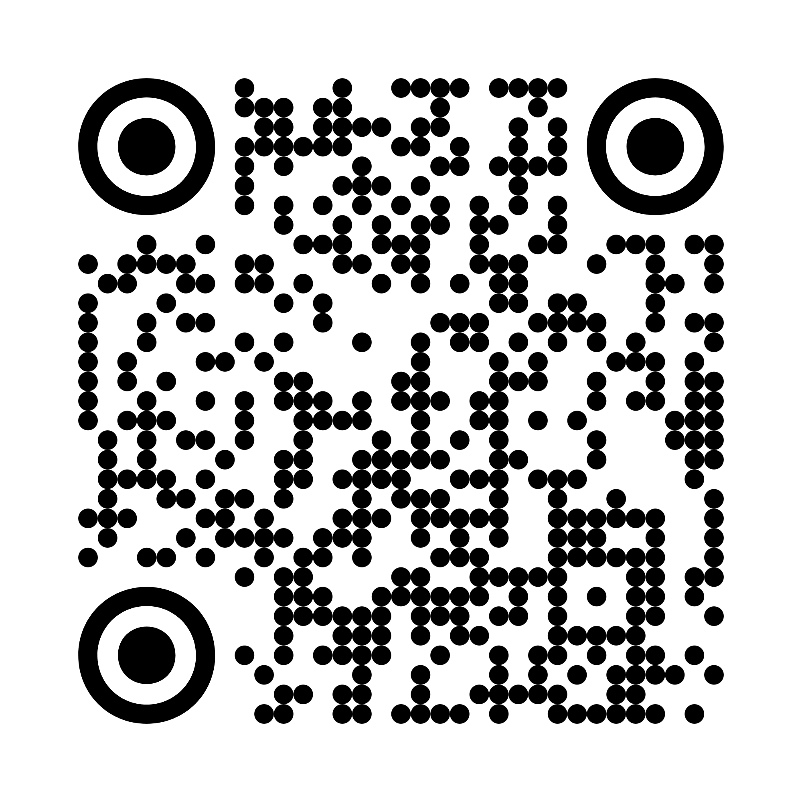
Braille Keypad Module
Thank You
Scan the QR codes given beside to access the source codes from GitHub repository owned by N. Manikanta Raghava
Appliance Control Module

